Slide 1
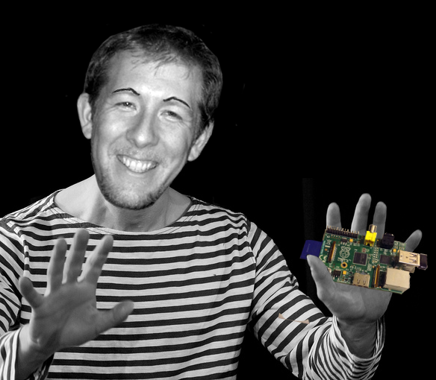
Phase 1: Get a Raspberry Pi, Phase 2: ?, Phase 3: Rule the World
Presenter: Nicholas Exner
Date: 2015.0130

Slide 2
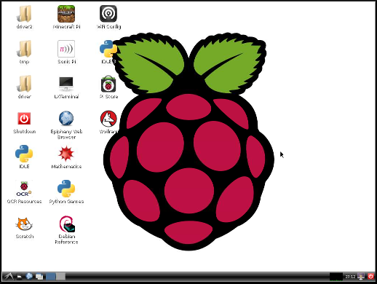
Today's Agenda
This presentation will provide an overview of the Raspberry Pi computing platform and some of its implications for transforming eduction.
What is the Raspberry Pi
Setting up the Raspberry Pi
Educational Uses
Minecraft
Scratch
Python
HTML 5
Fun Projects
Web Kiosk / Information Displayboard
Garage Door Opener
Voice Controlled Lamp
Helpful Resources

Slide 3
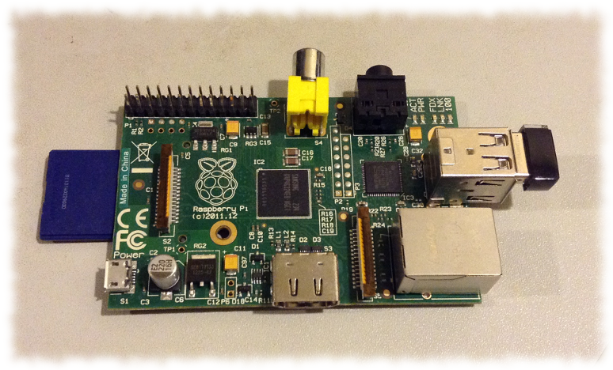
What is the Raspberry Pi?
The Raspberry Pi is a computer with the following traits that make it ideal as a tool to help bridge digital divides.
Low-cost computer ($25 - $35)
Size of a credit card
Graphics capabilities roughly equivalent to the original Xbox*
Performance close to a 300Mhz Pentium 2*
Strong community support
Energy efficient – can be ran off of batteries
* Performance data referenced from: http://www.raspberrypi.org/help/faqs/#buyingCost

Slide 4
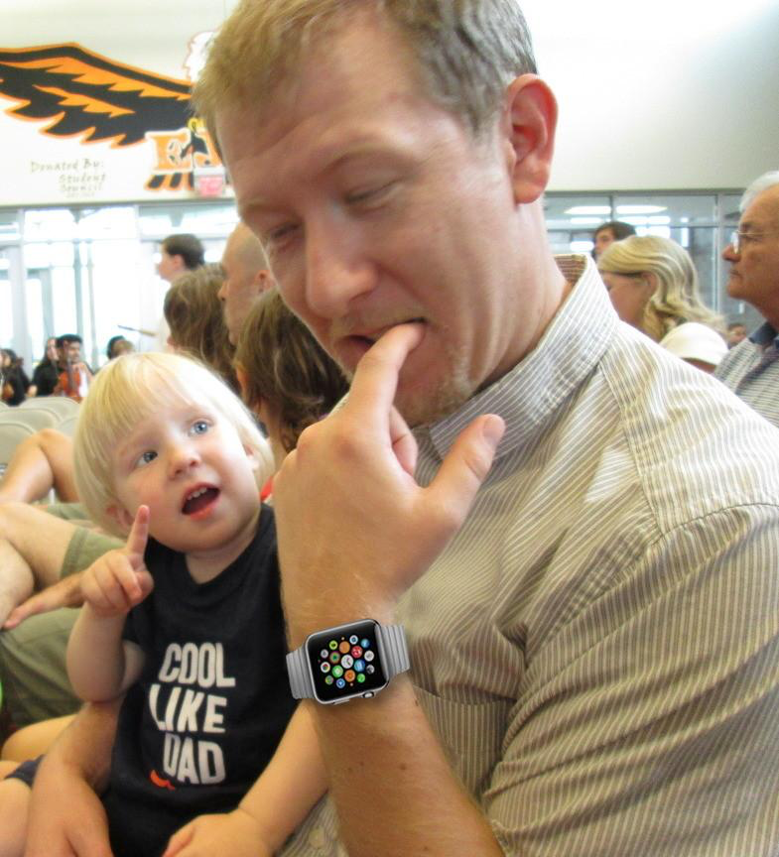
Setting Up the Raspberry Pi
The Raspberry Pi contains the motherboard, CPU, GPU, and memory, but often needs a few other components to be useful. These include...
Power adapter 5v - 750 mA - 1A
SD card – 4Gb or higher (micro-SD for + models)
Case (optional)
HDMI or RCA composite
video display devices
Keyboard
Mouse

Slide 5
Choosing an Operating System
After acquiring the hardware, one will be able to choose from a number of different operating systems.
Noobs – Image to choose some of the following
Raspbian – (Debian variant like Ubuntu)
Pidora – (Fedora variant like Red Hat)
Raspbmc – (Specialized media center)
Risc OS – (Non-linux; First OS for ARM CPUs)

Slide 6
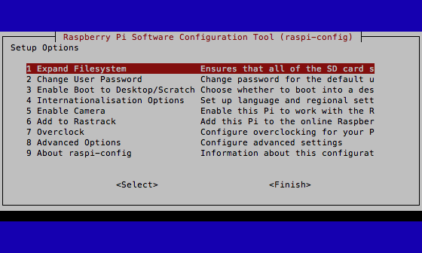
Configuring the Raspberry Pi
Once the Raspbian Operating System is copied to the memory card, the Pi can be configured.
Language and keyboard settings
Time zone preferences
Overclocking speed
Video memory split

Slide 7
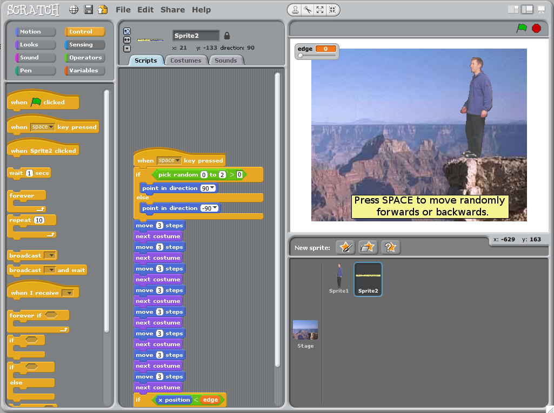
Educational Uses - Scratch
One of the most difficult things in teaching programming is in helping students get past the barriers of understanding syntax, keywords, and available operations. The second difficult feat is in making programming engaging. The Raspberry Pi runs Scratch which...
Allows for visual programming and graphic editing
Shows available options as widgets that can be drag-and-dropped
Makes creating animations easy
Allows sharing of completed applications with peers

Slide 8
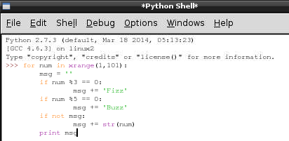
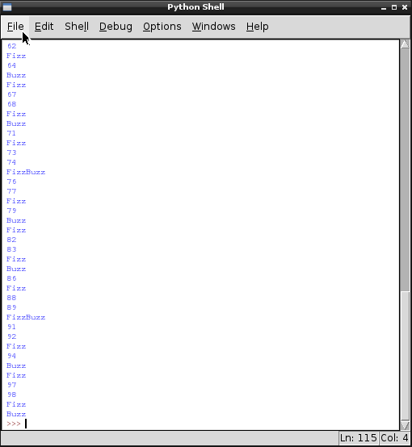
Educational Uses - Python
The Raspberry Pi supports the Python programming language. This is a general purpose language emphasizing readability. One exercise to try is programming the game of Fizz Buzz which has the following requirements.
Output numbers from 1 to 100
Print out the word Fizz for multiples of 3
Print out the word Buzz for multiples of 5
Print out the word FizzBuzz for multiples of both 3 and 5

Slide 9
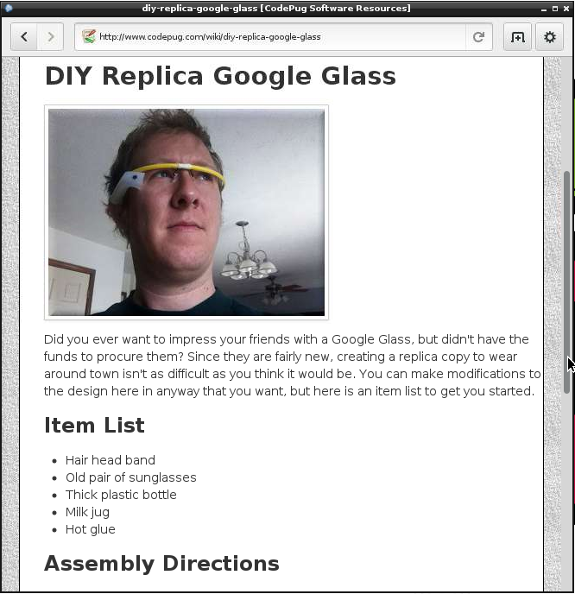
Educational Uses – HTML 5
With the new Epiphany web browser, students can learn how to create and view projects written to take advantage of the latest web technologies written in HTML 5.
Use the Pi to learn to write HTML, CSS, JavaScript
Leverage new frameworks used in the IT field including jQuery, angular, and more
Support for HTML video tags

Slide 10
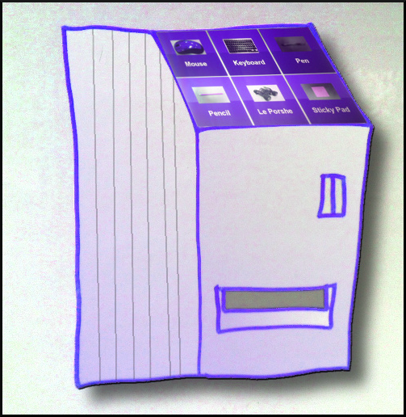
Fun Projects – Web Kiosk
With its built-in web browser, the Raspberry Pi can be readily configured to serve as an information display to show current events or with some hardware expertise even a digital vending machine.
Update the display from a local or remote website
Prevent the screen from going to sleep
Low cost / low power
Can even display video
GPIO pins can control the dispensing of items

Slide 11
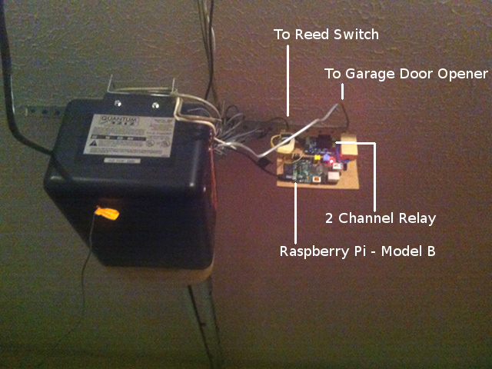
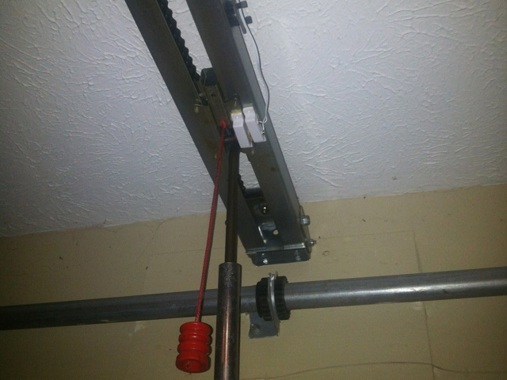
Fun Projects – Garage Door Opener
With a relay, wifi adapter, and a magnetic reed switch, the Raspberry Pi can be used to control a garage door from the Internet.
#!/bin/sh
if [ `gpio read 2` -eq 1 ]
then
/home/pi/t.sh Please standbye, the door is now opening.
else
/home/pi/t.sh Please standbye, the door is now closing.
fi
/usr/local/bin/gpio -g write 4 1
sleep .75
/usr/local/bin/gpio -g write 4 0

Slide 12
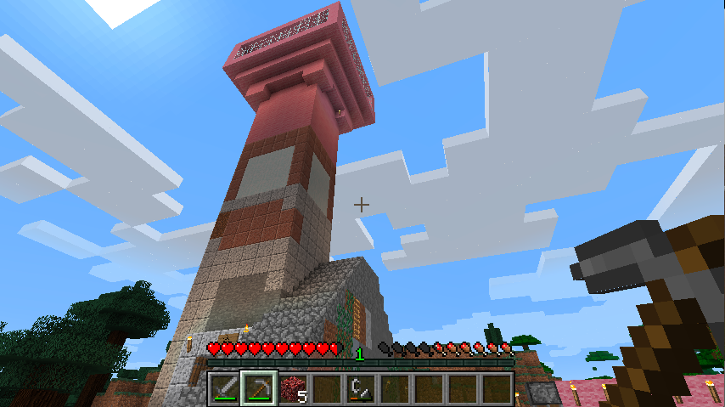
Educational Uses - Minecraft
Minecraft is now recognized as the 3rd most popular computer game of all time. * Not only does it have the ability to excite kids, but it also has a number of educational benefits.
Encourages reading (inventory items, online strategies)
Develops math skills (3D coordinates, building figures and shapes, calculating amount of materials)
Integrates with Python scripts via the Minecraft Python API
* http://www.ctvnews.ca/lifestyle/minecraft-why-are-kids-and-educators-so-crazy-for-it-1.2006975
** http://minecraft.gamepedia.com/Minecraft_in_education

Slide 13
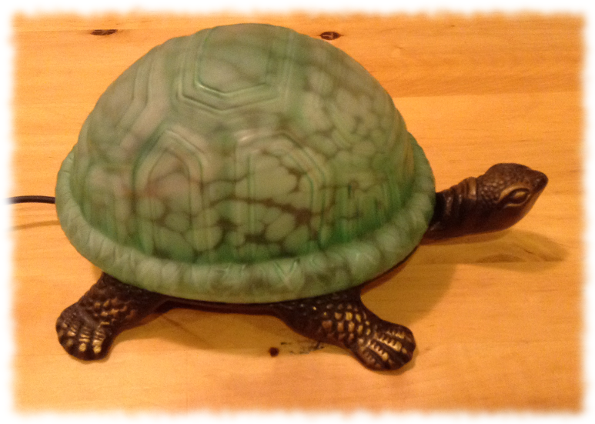
Fun Projects – Voice Controlled Lamp
Using some LED Christmas light bulbs, a microphone, and the PocketSphinx open source voice recognition library...
Retrofitted an old night light to hold a Raspberry Pi
Connected a microphone to an USB adapter
Trained the Pi to recognize a couple of words
Wrote code to activate the LED lights via the GPIO pins

Slide 14
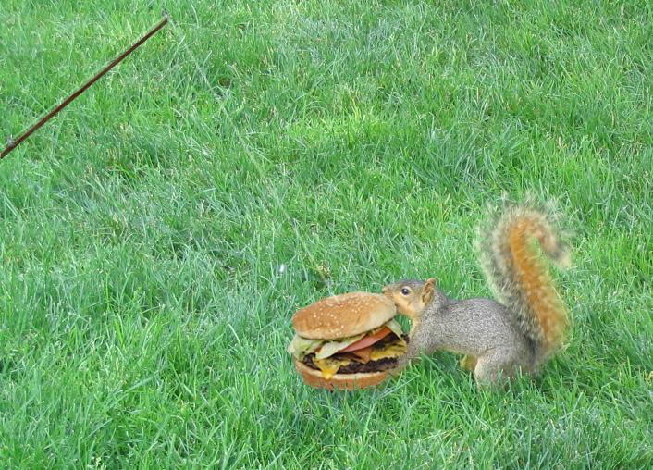
If I Haven't Hooked You Yet...
Did I mention that the Raspberry Pi also has...
Sonic Pi – An open source programming environment for creating new sounds with code
Mathematica 10 – computational programming tool used in science, maths, computing, and engineering
A version of the latest Java 8 Development Kit that can be installed from Oracle

Slide 15

Helpful Resources
The following web sites provide additional information about the Raspberry Pi.
The Official Raspberry PI - FAQ
http://www.raspberrypi.org/help/faqs/#videoDisplays
CodePug Wiki – Project How-To's
http://www.codepug.com/wiki
Amazon Offerings
http://www.amazon.com/s/ref=nb_sb_noss?url=search-alias%3Delectronics&field-keywords=raspberry+pi&rh=n%3A172282%2Ck%3Araspberry+pi&ajr=0
Risc OS FAQ
http://www.riscos.com/the_faqs/

